Slide 1


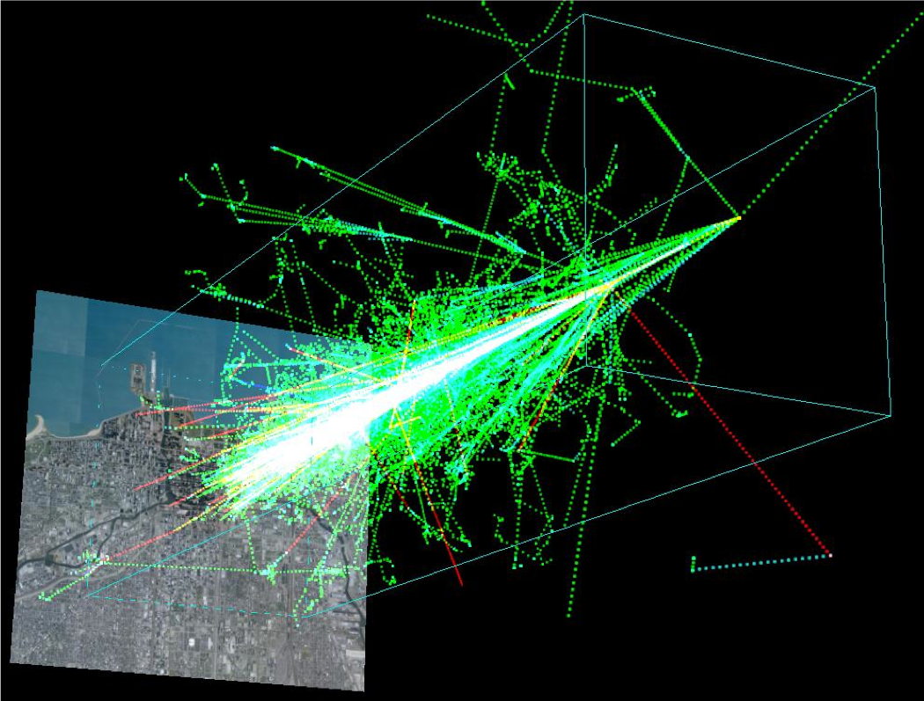

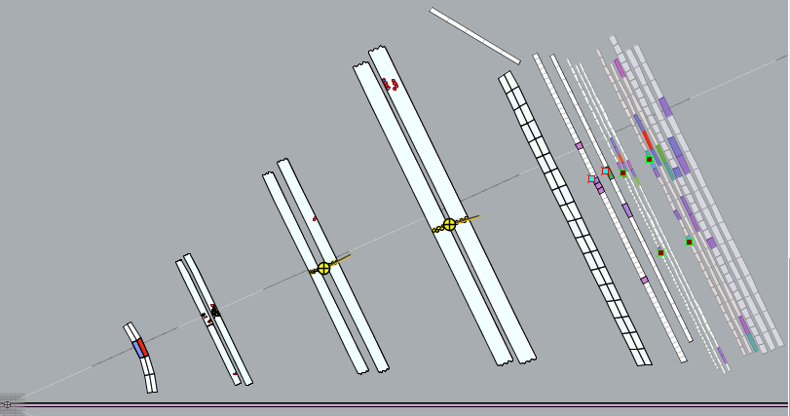
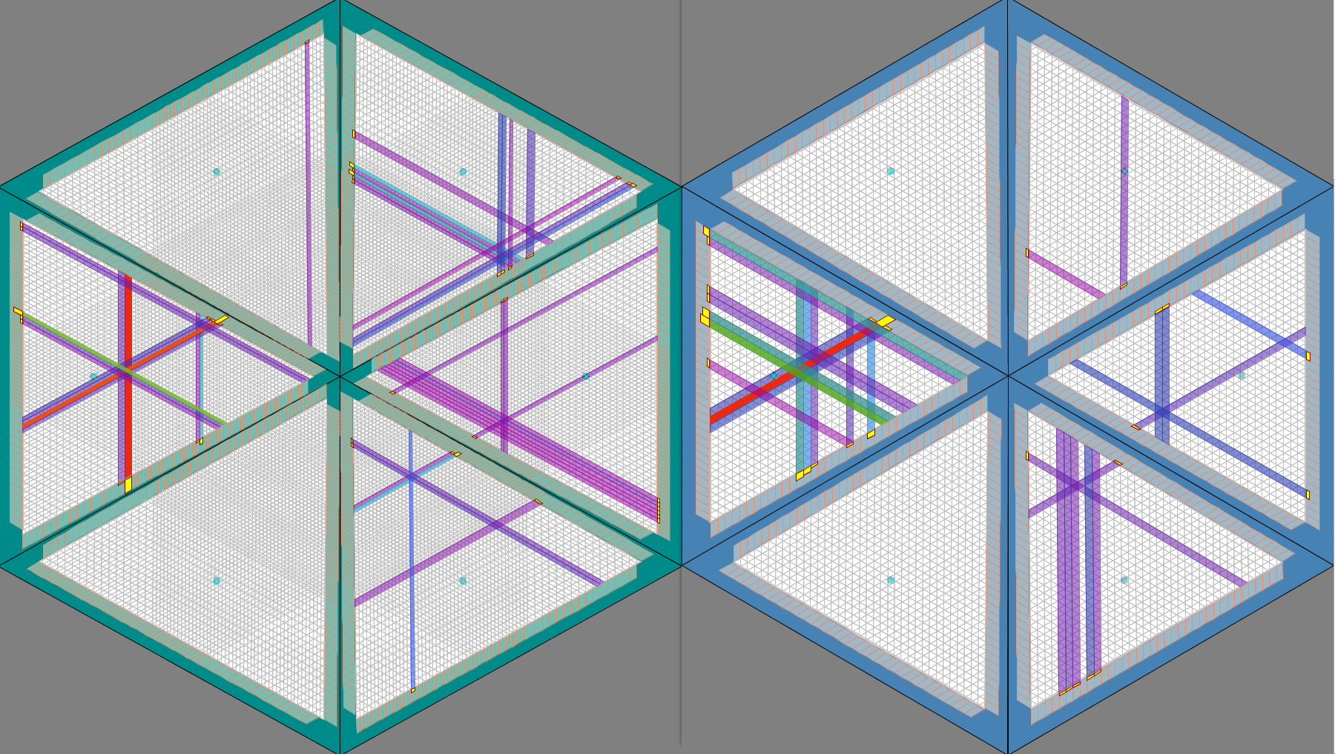
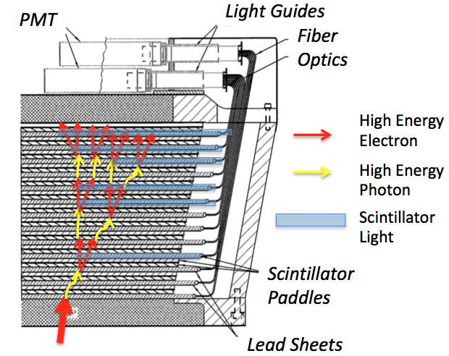
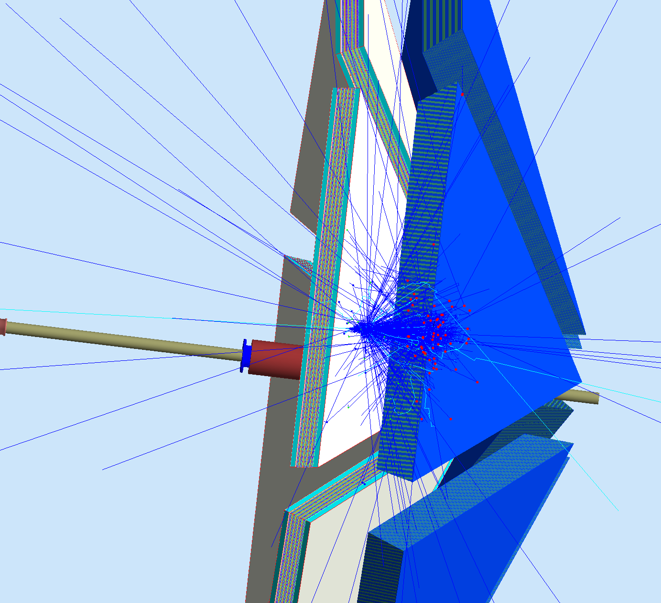
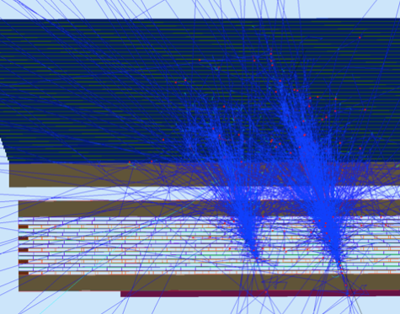
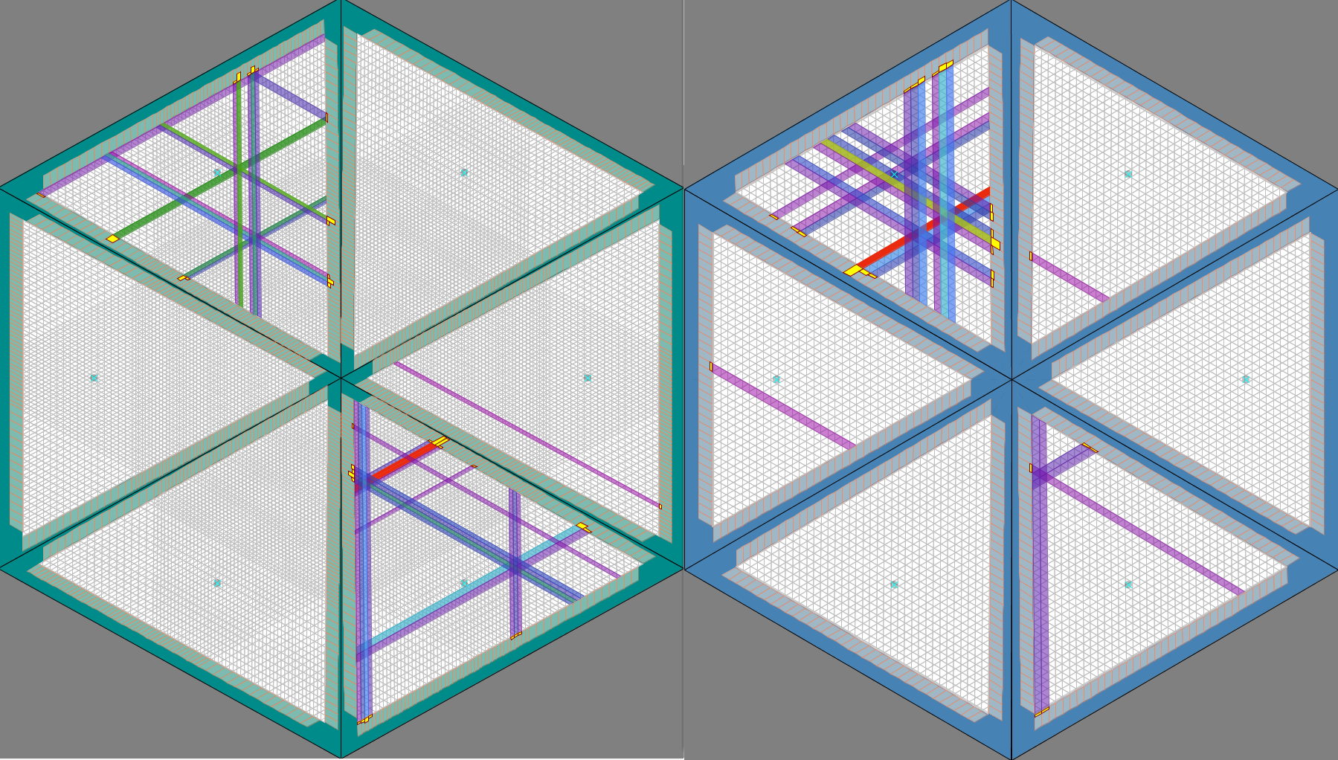
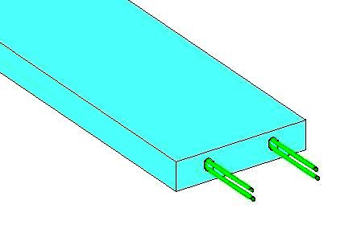
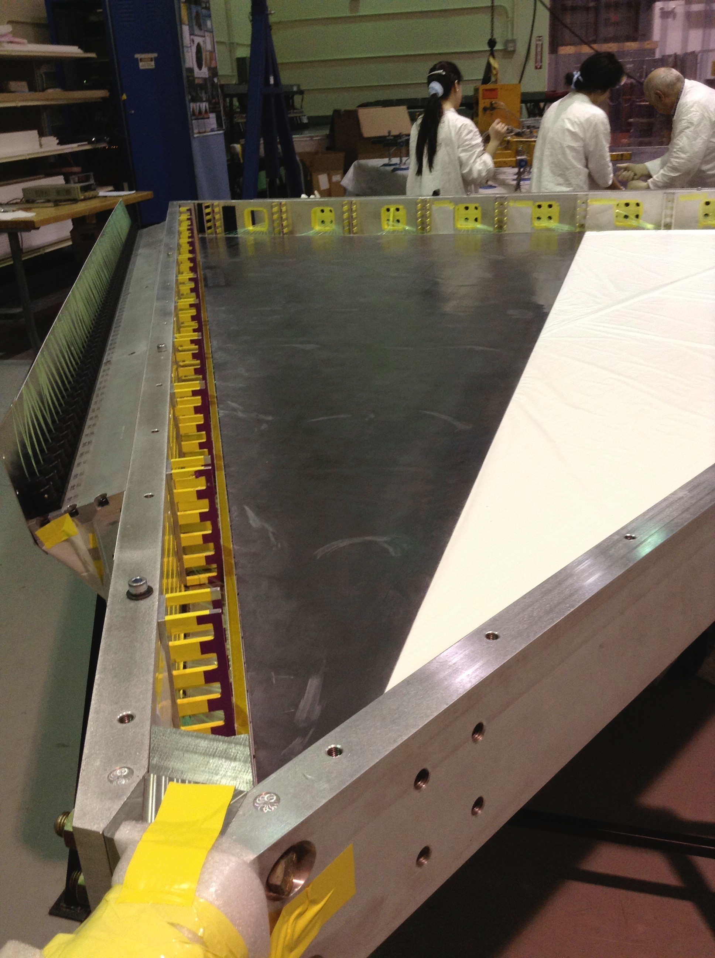
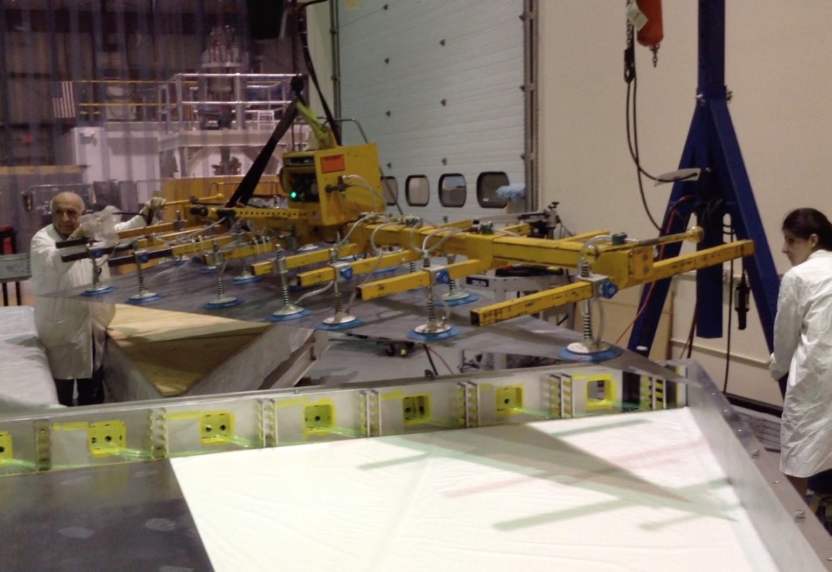
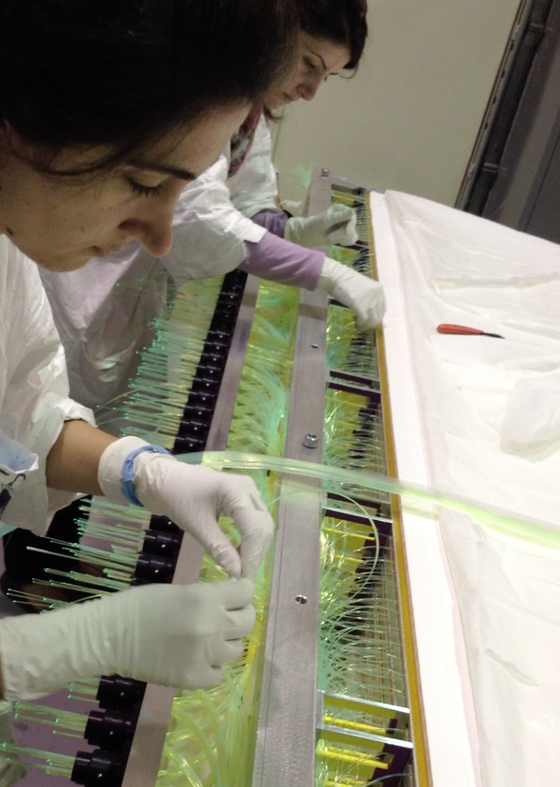
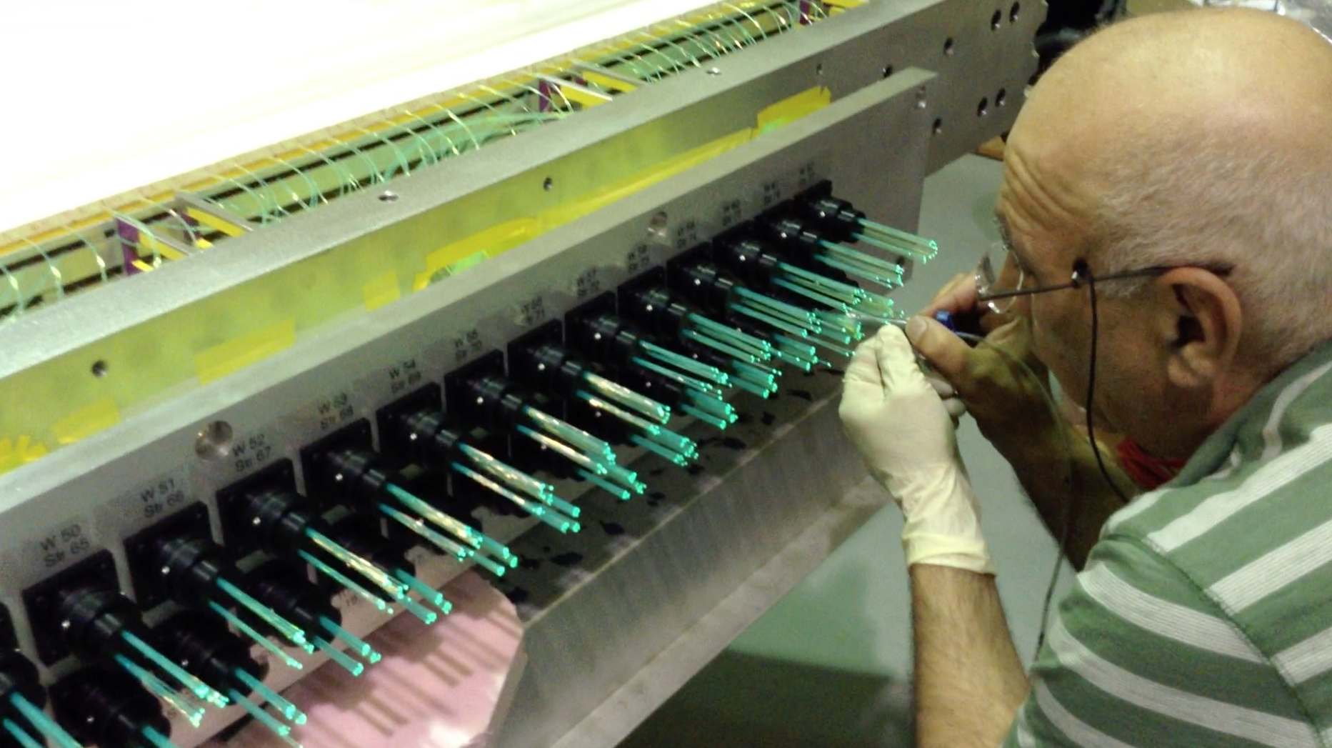
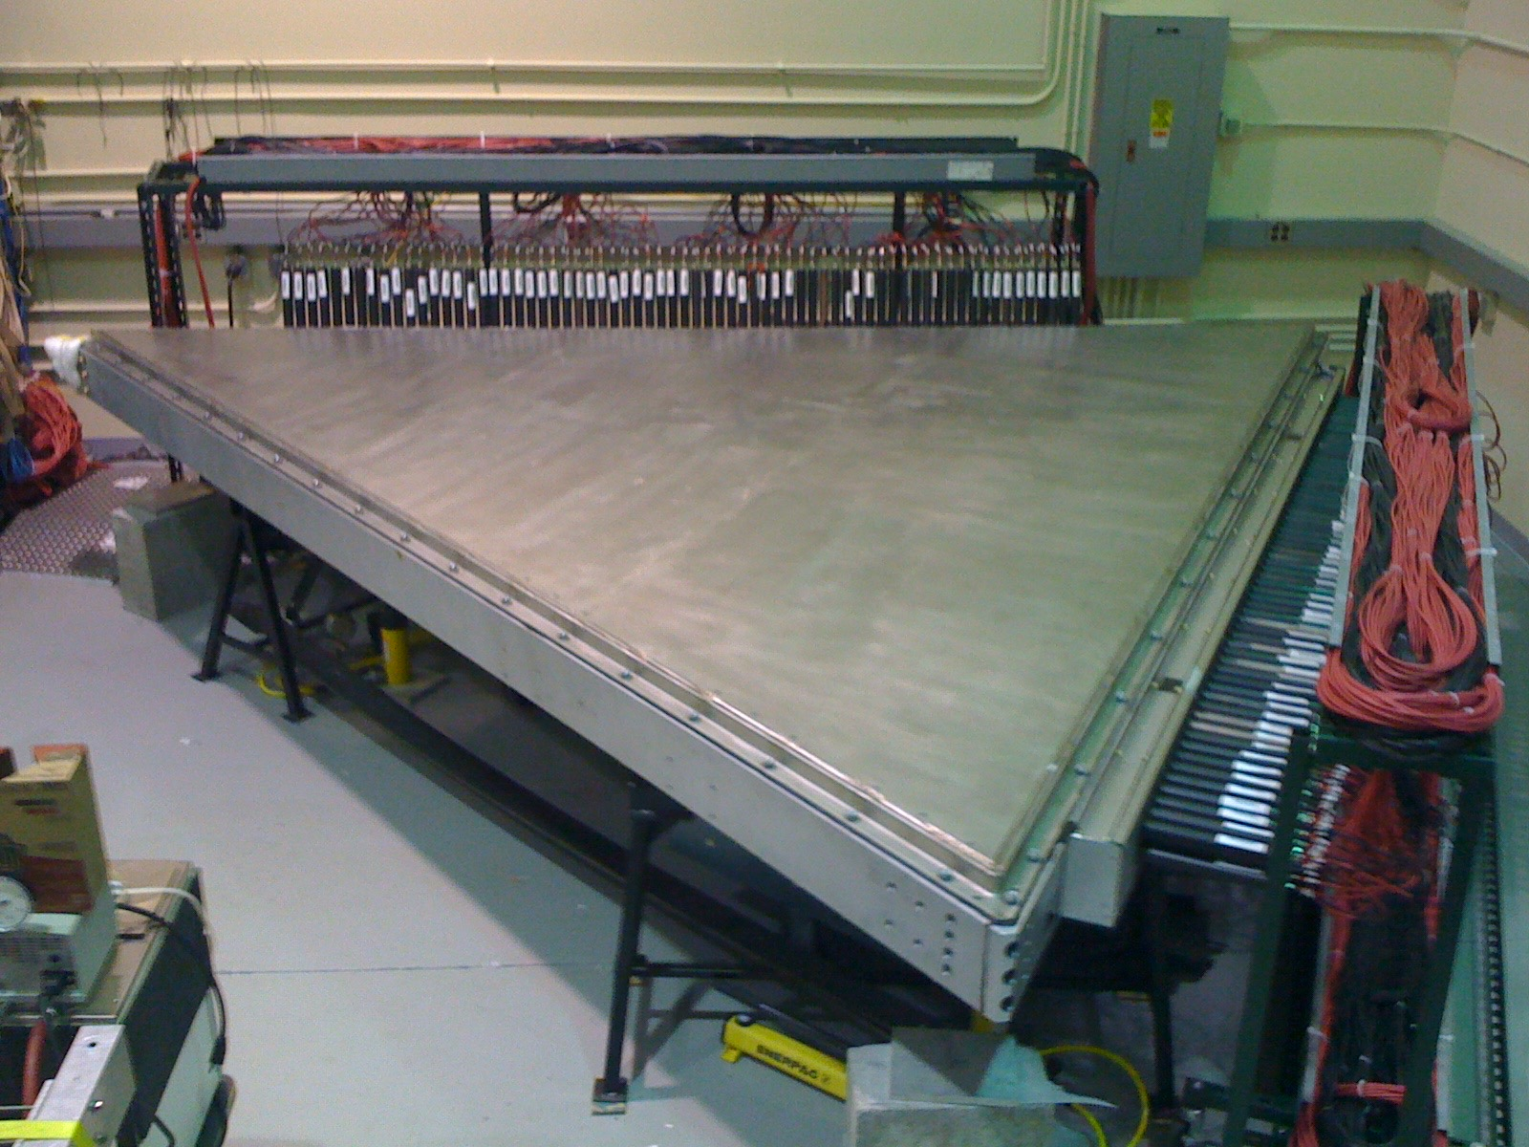
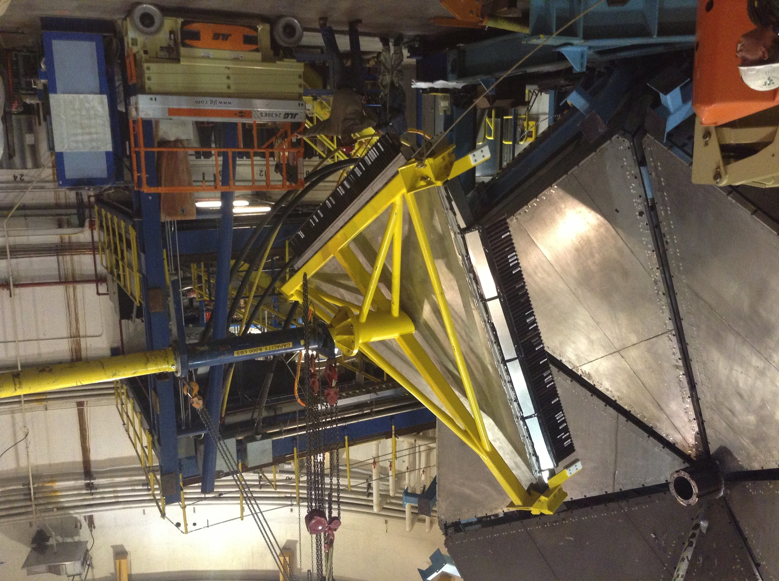
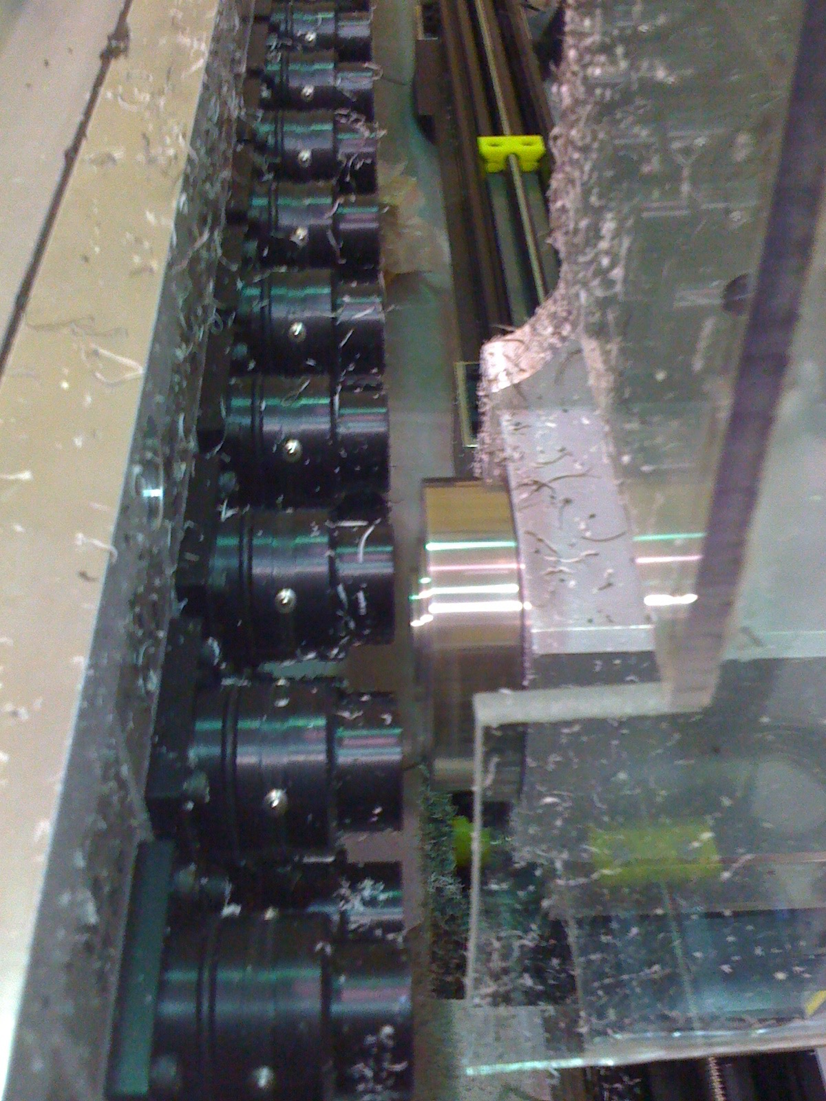
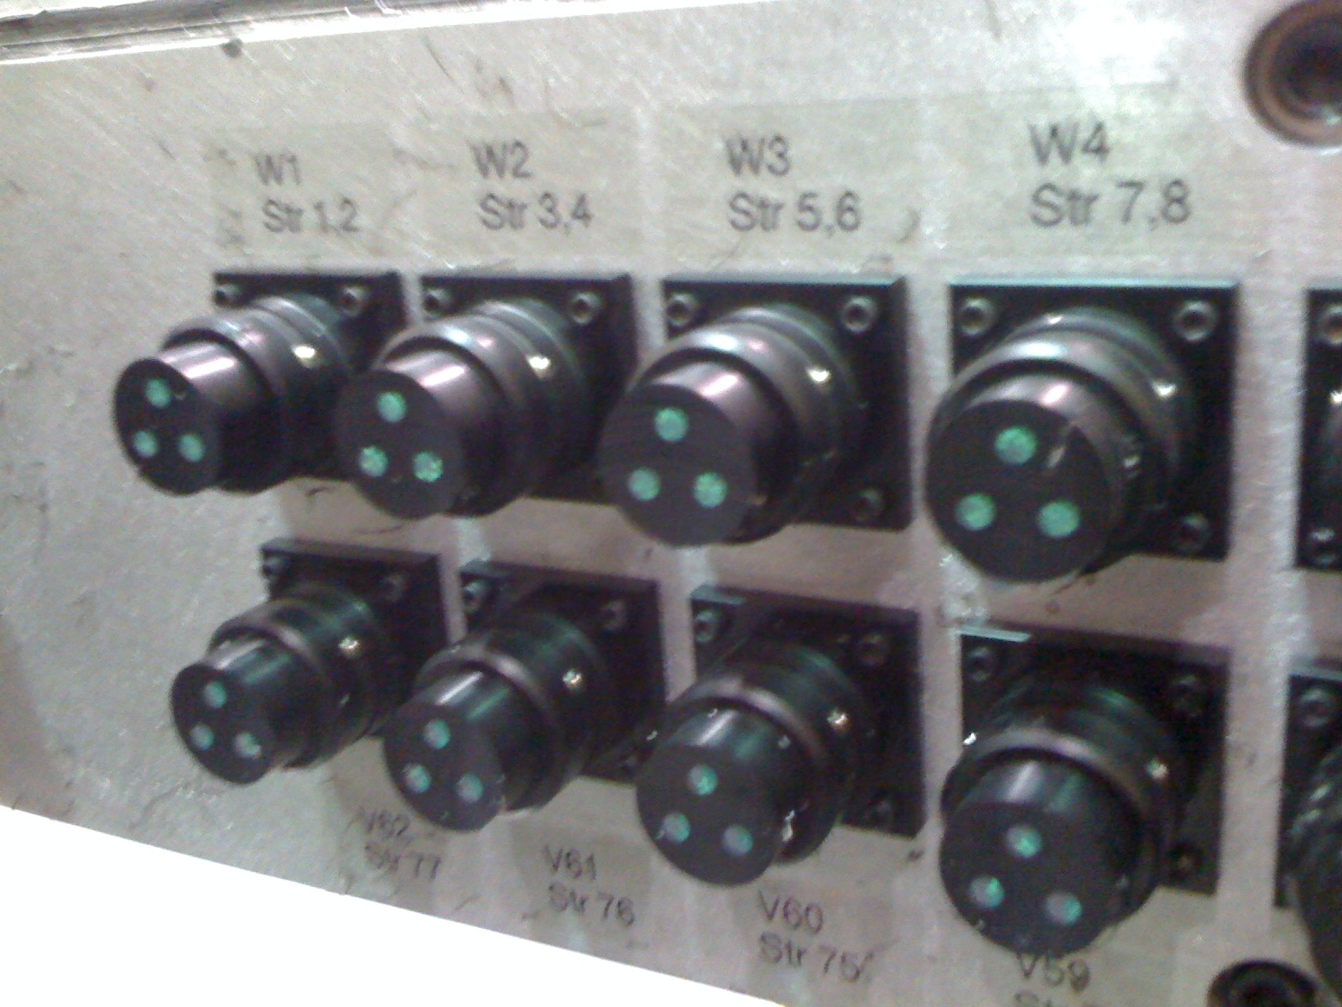
Electromagnetic Calorimeters
Thomas Jefferson National Accelerator Facility
What is it
PCAL and ECAL In Action
The Electromagnetic Calorimeters (PCAL and ECAL) are used to:
1. Capture high energy electrons and photons
2. Measure their energy, time and position.
3. Perform ultra-fast discrimination between electrons and pions /protons
Run: 2869
Event: 1321781
Trigger: e- Sector 1
DC 3
PCAL
3
As electrons and photons cross the calorimeter they convert their kinetic energy in photons. In turn, the photons produce more electrons. We call this chain reaction a “shower”.
The calorimeters are designed to make the electrons shower until they are captured. The light emitted by the showers is piped with fiber optics to computers electronics.
Since other particles do not “shower”, physicists use the calorimeters to select which information to write on tape. This decision making process, called “trigger”, is fundamental to save taxpayers money on cpu, disk and tape space. We are able to make these discriminations 20,000 times every second.
DC 2
ECAL
1
DC 1
4
HTCC
5
PCAL
LTCC
FTOF
Left: One electron (red track) detected in one CLAS12 Sector. You can see it produces hits in most detectors: HTCC, all three Drift Chambers, the FTOF and finally it showers in the PCAL and ECAL.
The track of the electron through the CLAS12 detector can also be seen by the hits recorded in the Drift Chambers (DC) and Forward Time-of-Flight (FTOF) counters.
Right: the electron signal in PCAL released energy in all 15 layers and was detected by in multiple intersections of 3 strips. We call these ”pixels”.
Schematic picture of the development of an electromagnetic “shower” in the ECAL. An electron hits a 2.2 mm lead sheet which causes it to give off a high energy photon. The photon hits another lead sheet and produces a pair of electrons (+ and -) that in turn emit more photons. The process continues like a chain reaction until the electron energy is used up.
Detecting multiple photons
The photons showers are analyzed by special software that investigates the PCAL and ECAL signals: we can calculate the photons energy and their direction, even when photons are very close together.
PCAL and ECAL can reconstruct neutral pi-mesons by measuring their nuclear decay into two photons:
The computer simulation at left shows two photons entering PCAL from the decay of a 10 GeV neutral pion. Can you make out the two showers on the right? Our software can!
Computer simulation of a shower in PCAL and ECAL. The electron converts into photons and other electrons pairs, until all its energy is released in the calorimeters in the form of light. Each of the red and blue dots represents about 500 photons being transported to computer electronics.
Tech Specs
Number of channels: PCAL 1152 ECAL 1296
Readout methods:
PCAL 28560 WLS fibers
ECAL 28512 Optical fibers
Number of sandwich lead/scintillators layers:
PCAL: 15 layers
ECAL: 39 layers
Scintillator material – PCAL extruded polystyrene with TiO2 coating ECAL BC-412
Scintillator areas– PCAL 1 cm x 4.5 cm ECAL 1 cm x 10 cm
Light yield (photoelectrons/MeV) – PCAL 11-12 ECAL 3-4
Wave-shifting Fiber Readout for PCAL provides higher light yield from the scintillators
Building and Installing the PCAL
Did you know?
At almost 500 square feet of area coverage, the Hall-B calorimeters are the largest calorimeters ever built.
The “P” in PCAL stands for Pre-Shower, which means the PCAL is used to start the Electromagnetic Shower.
While the PCAL modules are brand new, the ECAL modules have been rocking Hall-B continuously since 1996, with little to no signs of age!
The calorimeters can function as a cosmic-ray telescope, as every pixel (intersection of 3 strips) points to a unique point in the sky. Muons generated from stars and supernovas are used to calibrate both calorimeters
The PCAL has 1152 channels. The ECAL has 1296. The signals from all these are digitized 250 million times every second.
The total weight of PCAL is 66 tons, or 132,000 lbs.
The total weight of ECAL is 96 tons, or 192000 lbs.
Each PCAL box contains a stack of alternating layers of 2.1 mm thick lead sheets and 4 cm wide by 1 cm thick scintillator strips. Each box has installed 1190 strips and 28 half-sheets.
Installing the heavy lead sheets required a movable rig with vacuum suction cups that uniformly lifted the sheet and allowed precise positioning and adjustments. Thickness of each sheet was measured at 36 points prior to installation to insure uniformity within 0.1 mm. Hakob Voskanyan is shown transporting one of the half-sheets.
Each of the 1190 scintillator strips used 4 wave-shifting fibers to transport the light to PMT housings. A total of 28560 fibers were individually installed and routed to the electronics. Yeran Ghandilyan and Ani Simonyan, shown here, did much of this work.
A cantilevered lifting fixture was designed to Install each of the 6 PCAL modules in front of the existing ECAL modules. Each PCAL weighs about 11 tons, and each ECAL module about 16 tons.
Contributing Institutions
Jefferson Lab. Newport News, VA, USA
Fermilab, Batavia, IL, USA
Yerevan Physics Institute, Yerevan, Armenia.
Ohio University, Athens, OH, USA
James Madison University, Harrisonburg, VA, USA
University of Virginia, Charlottesville, VA, USA
Norfolk State University, Norfolk, VA, USA
Wave-shifting fibers were individually glued into their PMT housings (top) and milled and polished with a custom programmable fly-cutting head (left). Above shows housing ready for PMT installation.
After PMT installation each PCAL module was connected to high voltage and signal cables to check proper operation of the electronic readout. Cosmic rays were used to determine calibration constants used to convert raw voltage signals from the PMTs into energy in MeV deposited in the scintillators. Corrections for light attenuation in the WLS fiber readout were also determined using this test setup.

